Slide 1

PlaatProtect (Burglar / Fire Alarm Centre) Open Source Project
W.B.J. van der Plaat
(Principal IT Architect)

Slide 2

Questions
How can I protect my family against burglars?
How can I protect my family against fire?

Slide 3


Idea
Lets create an application which detect movement & fire in my house and activate the necessary counter measure.
Control the system around the world
Use low cost hardware
Use Z-Wave technology
Use Zigbee technology

Slide 4

PlaatProtect - Features
Burglar / Fire Alarm Centre on Raspberry Pi
Integrate Webcams
Motion detection with auto recording
Integrate Zigbee meshwork
Control lights
Fire detector
Integrate Z-Wave meshwork
IR detector(s)
Alarm Horn
Keypad
Notification
Push Message to Mobile
Email
Scenario support
Home, Sleep, Away

Slide 5
PlaatProtect Software Architecture
Google Charts
Mobile Push Service
Email Push Service
WS / JSON
Presentation Layer
PHP/CSS/JS
Apache
Business Logic Layer
PHP
Database Layer
MySQL
REST
Interface
Zigbee
Interface
Z-Wave
Interface
Webcam
Interface
PHP
Operating
System
Debian Linux
Vendor Support
Philips HUE
Vendor support
Google Protect
Vendor support
- Aeotec
- Aeon
Vendor support
Sony
Logitec

Slide 6
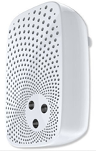

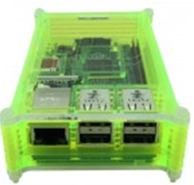
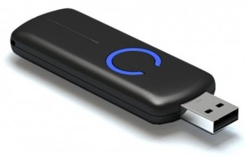
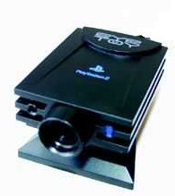

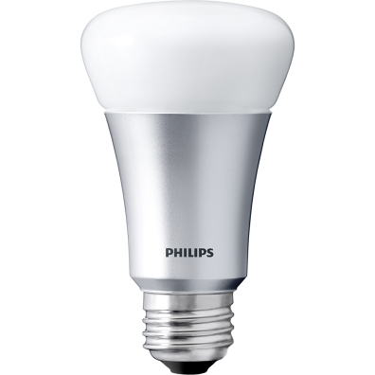
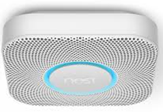
Used hardware
Raspberry Pi 3B
Philips Hue Light Bulb
Philips Hue Light Strip
Z-Wave USB Dongle
Z-Wave Aeon Horn
Z-Wave Aeotec IR detector
Google Nest Protect
USB Webcam

Slide 7





Hardware View – Configuration 1
Light
Bulb
Light
Strip
Zigbee
(mesh network)
Raspberry Pi
PlaatProtect
Sense Hat (Pi)
Wifi
Wifi Router
Ethernet
USB
Z Wave
(mesh network)
Ethernet
ADSL Router
USB
USB
Ethernet
IR
Detector
Notification
Internet
Alarm
Horn
Webcam
1
Webcam
2
IR
Detector

Slide 8
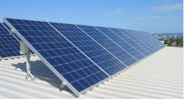
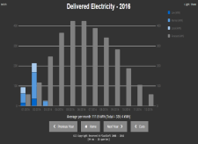
Hardware View – Configuration 2
P1 cable
Digital Energy
Meter
Light Bulb
Light
Strip
Bluetooth
USB
Digital Gas
Meter
Solar
Converter
Raspberry Pi
PlaatEnergy
PlaatProtect
Sense Hat (Pi)
Zigbee
(mesh network)
Wifi
Wifi
Ethernet
Z Wave
(mesh network)
Wifi Router
USB
Z Wave
(mesh network)
Ethernet
ADSL Router
USB
USB
Ethernet
IR
Detector
Notification
Internet
Alarm
Horn
Fire
Detector
Webcam
1
Webcam
2

Slide 9
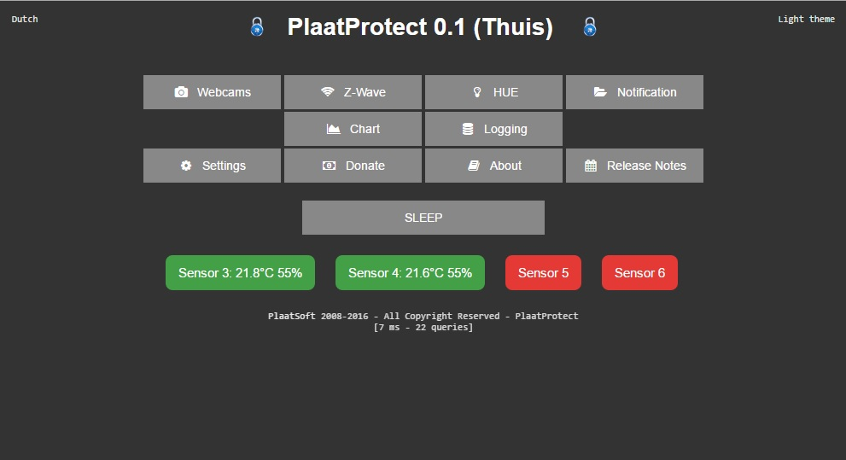

Slide 10
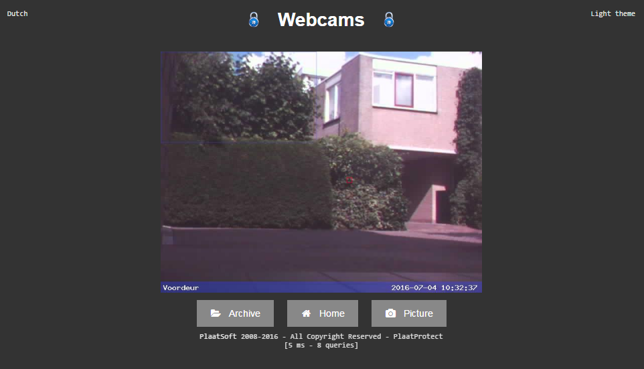

Slide 11
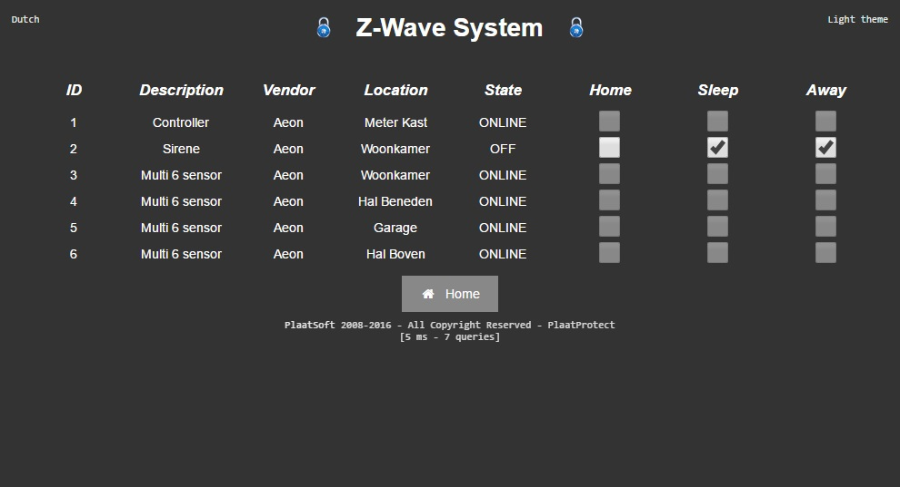

Slide 12
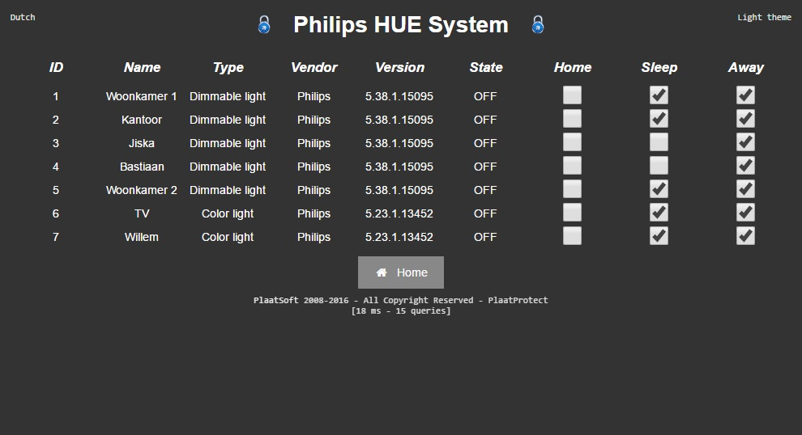

Slide 13
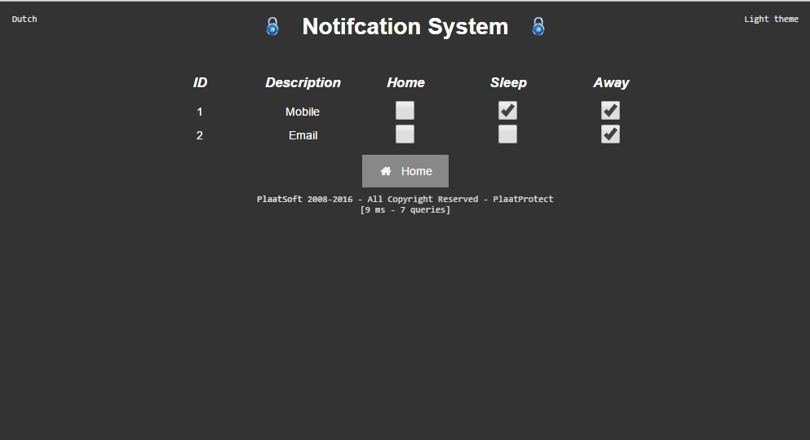

Slide 14

IR
Detector
More info
visit
plaatsoft.nl

